Slide 1
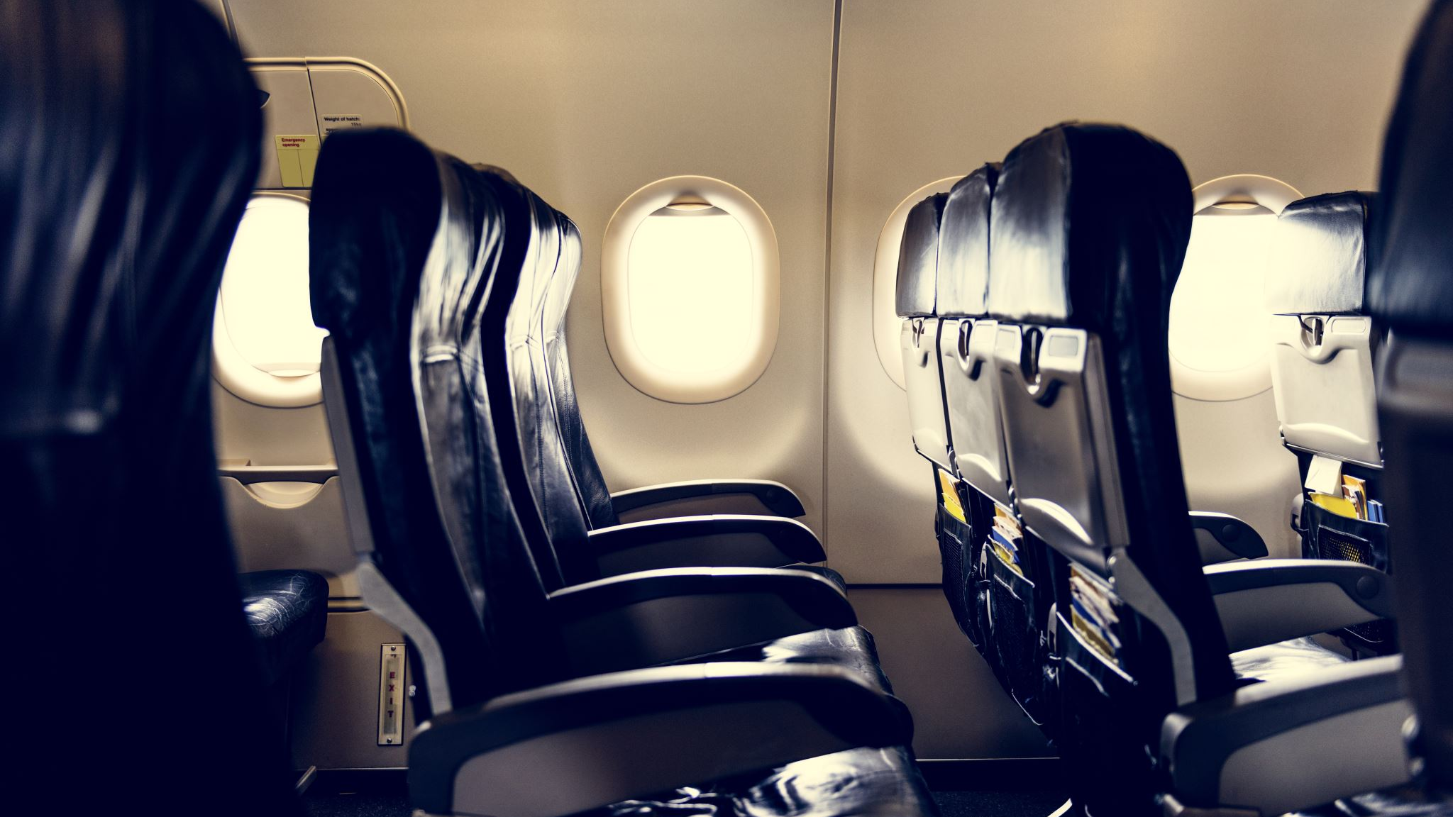
BRITISH AIRWAYS CUSTOMER PREDICTION

Slide 2
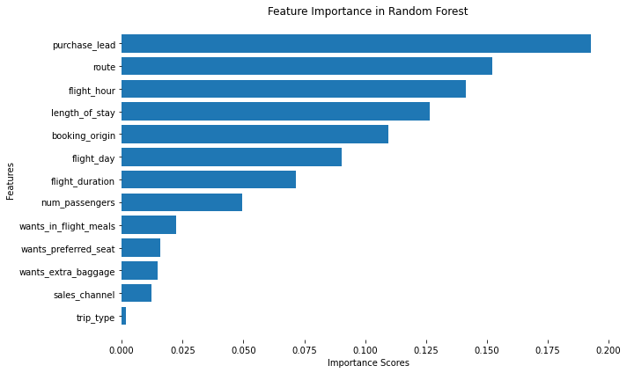
Evaluation
The most important feature for making the booking complete is Purchase lead which represents number of days between travel date and booking date
The Route, Flight hour and Length of the stay also have a significant impact. However, Sales channel and Trip type has the less impact
The Random Forest Classifier model has predicted the customer booking with an accuracy of 85%.
To Improve the model, we need to consider adding more features as Promotional offers, Type of cards used for purchase.

